Slide 1
Storing Electricity for Our Future
February 2017

Slide 2
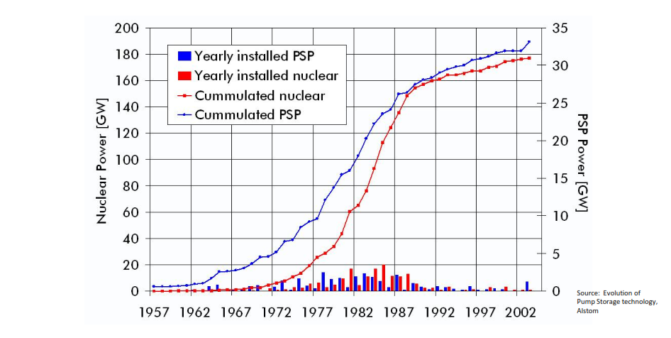
Matching inflexible generation to load is not new
Pumped hydro was invented in the 1870s in the Alps and installed in Europe in the 1970s through the 1990s, in parallel with the build out of nuclear generation
Pumped hydro energy storage is used worldwide for multiple applications:
Generation on peak
Frequency regulation
Spinning reserves
Like pumped storage, today’s storage technologies should be valued for the full spectrum of applications that they can provide.

Slide 3
Industry built on low asset utilization
Electricity is the most capital intensive industry – in the US, $3 of assets required for $1 of annual revenues
New England Load Factor,
Summer Peak, 1991-2024
US Peaking Power Plant Utilization
Load Factor (%)
Load factor has dropped by ~15%
Capacity Factor (%)
50% have < 2% capacity factor
Percentage of Simple Cycle Combustion Turbines (%)
“The greatest engineering achievement of the 20th century”
- National Academy of Engineering
Sources: EPA, ISO-NE

Slide 4
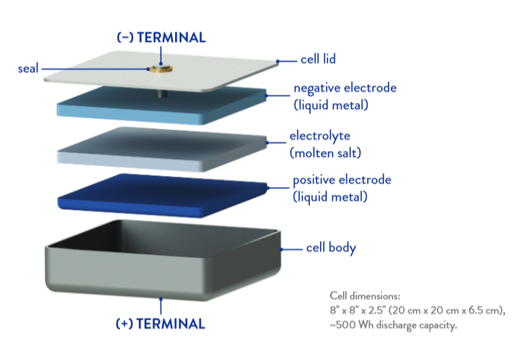
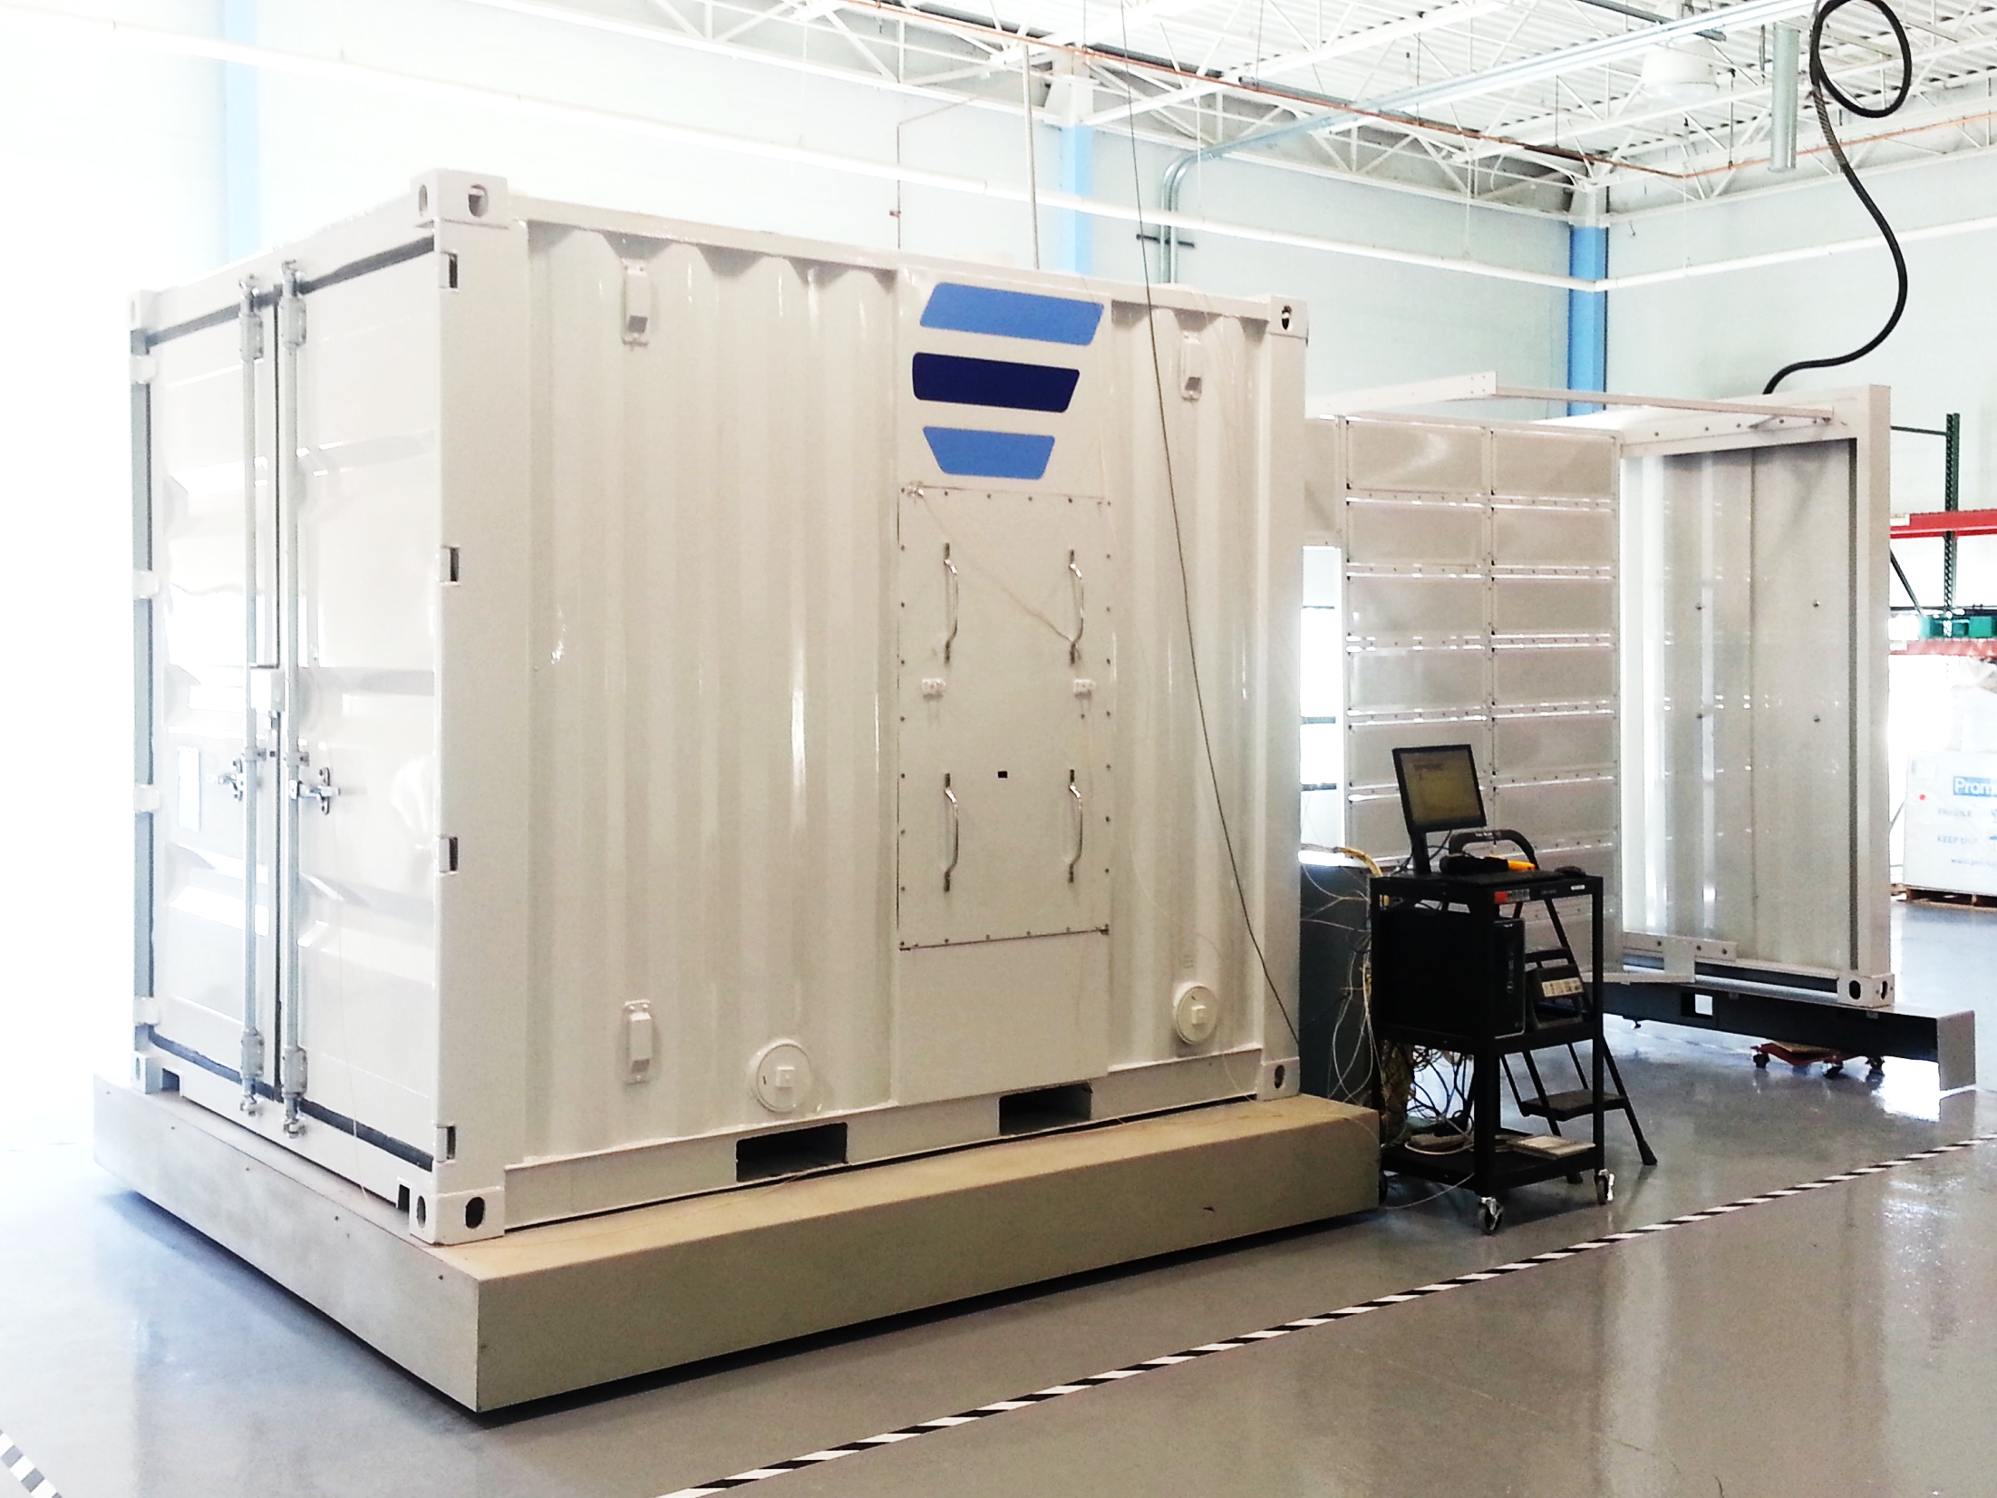
Ambri’s Liquid Metal Battery cell technology is an innovative approach to grid-scale storage
Negligible Fade
Ongoing
Ambri Energy Storage System
600 to 750 kWh
80% round trip efficiency
20 year design life
Respond to signals in milliseconds
Focused on 4-12 hour applications
Unaffected by ambient temperature

Slide 5
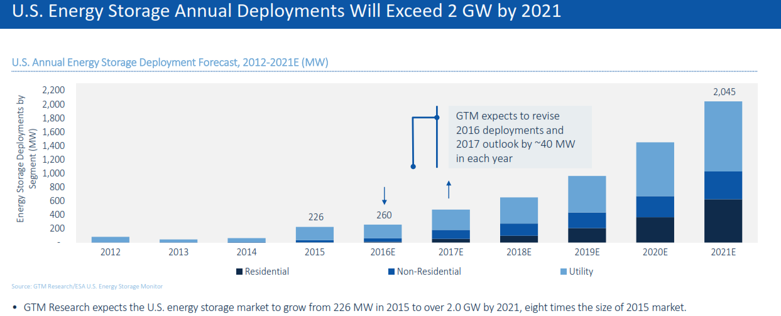
Storage Market Opportunity
Demand response is a relevant analogy for storage
Frequency regulation market transformed
Capacity, non-transmission and non-distribution opportunities emerge
Transformation of energy markets with renewables
*Sources:
Transmission and generation figures: http://www.monitoringanalytics.com/reports/PJM_State_of_the_Market/2015/2015-som-pjm-volume2-sec1.pdf
Distribution figures: http://www.eia.gov/forecasts/aeo/data/browser/#/?id=8-AEO2016&cases=ref2016~ref_no_cpp&sourcekey=0

Slide 6
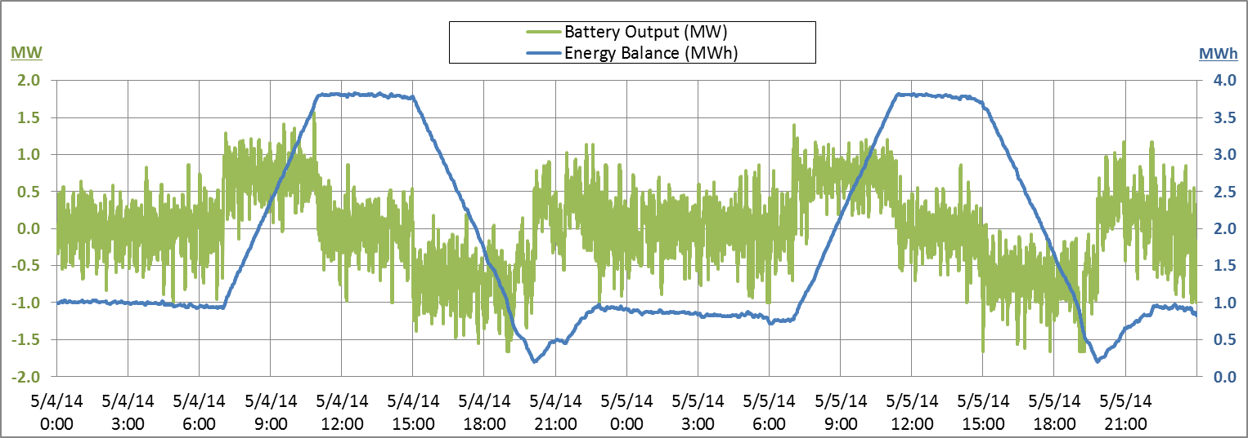
Storage is both a great energy and power resource
Example:
4MWh Ambri storage system
Two days of simulated frequency response + ramping support + load shifting
Charging during morning ramps
Ongoing frequency response
Discharging during afternoon/early evening peaks

Slide 7
Island case study: profiles
Load with 80 MW solar:
SOLAR ALONE:
with 80 MW of solar, net load swings are dramatic and not all solar generation is able to be consumed
SUSTAINABLE SOLAR WITH STORAGE:
storage enables 30+% solar generation mix
Load with 80 MW solar, 120 MWh storage:
Load with 160 MW solar, 360 MWh storage:
SOLAR AND STORAGE TRANSFORMATION: storage enables 60+% solar generation mix

Slide 8
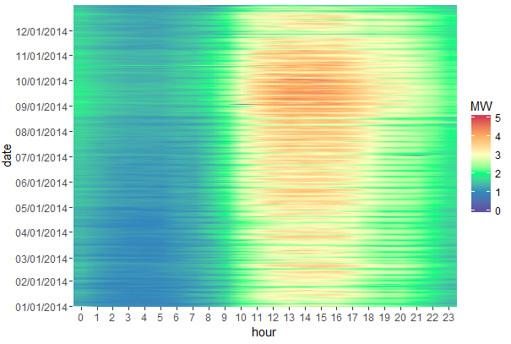
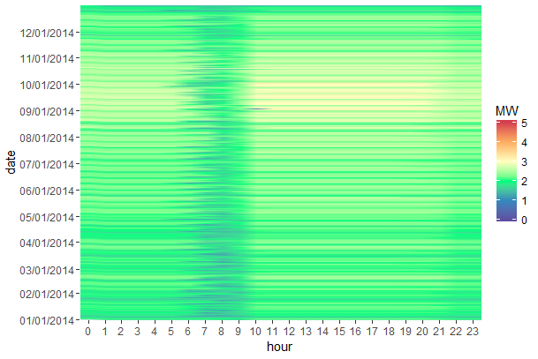
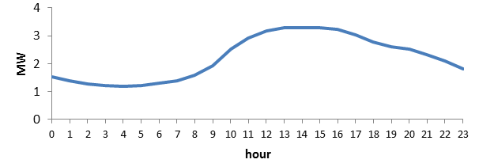
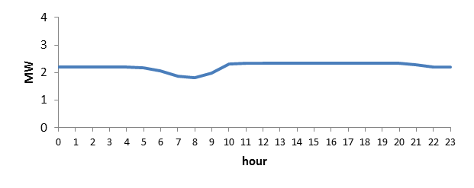
Storage increases system load factor
Storage can be used to peak shave at substations, distribution feeders and behind the meter
Typical load factor increases of 20-40%
Annual Load Fingerprints:
Gross load
High mid afternoon peaks
Load shifting via storage
Storage smooths load

Slide 9
Ambri on path to transform global power markets
Electricity demand worldwide is increasing as populations and economies grow. | Massive infrastructure investment is needed -- $17 trillion; storage can significantly reduce needed infrastructure. | Storage will change how electric systems are engineered – building to average demand rather than peak.
Capacity Needed
with and without Storage
Capacity Today
Peak
Demand
Capacity
with
Storage
MW
Average Demand
hours
Source: IEA, World Energy Outlook 2012

Slide 10
Thank you for your interest
To learn more:
Visit www.ambri.com
Subscribe to company updates
Phil Giudice
Chief Executive Officer
pgiudice@ambri.com
617.714.5723 ext. 450
David Bradwell
Chief Technology Officer
dbradwell@ambri.com
617.714.5723 ext. 451
Don Sadoway
Co-Founder, Chief Scientific Advisor and Board Member
dsadoway@mit.edu
617.253.3487
Kristin Brief
VP of Corporate Development
kbrief@ambri.com
617.714.5723 ext. 453

